Slide 1
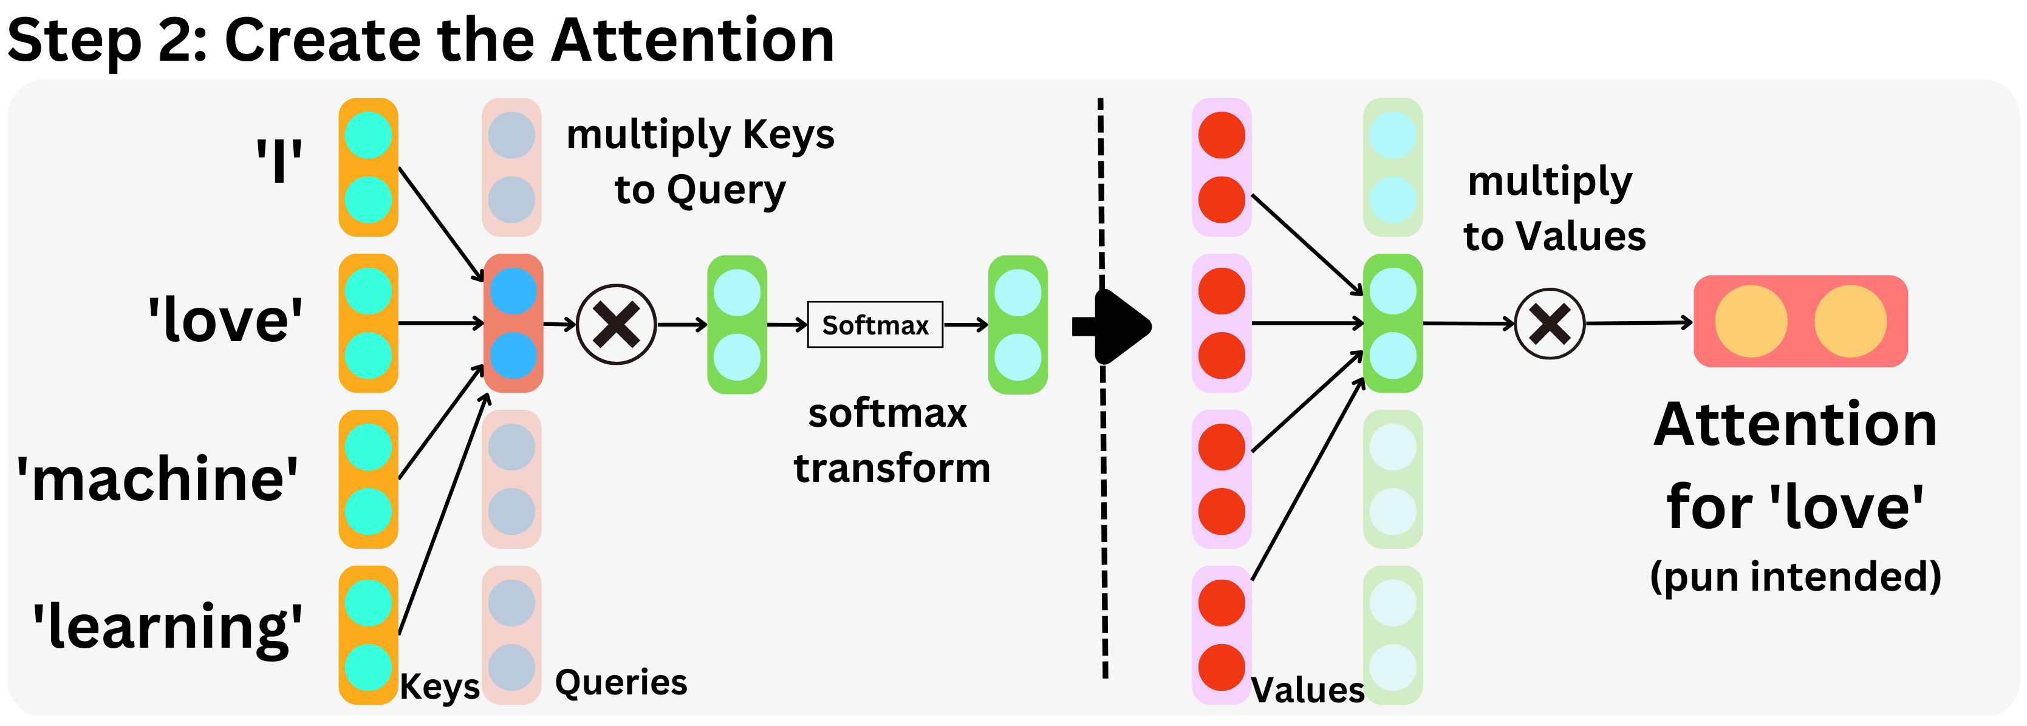
Self-Attention: Understanding Context
Self-attention allows a model to "look" at all words in a sentence simultaneously to understand the context of a specific word.
It creates a dynamic relationship between words regardless of how far apart they are in a sentence.
The mechanism uses three distinct vectors for each word: Query (Q), Key (K), and Value (V).

Slide 2
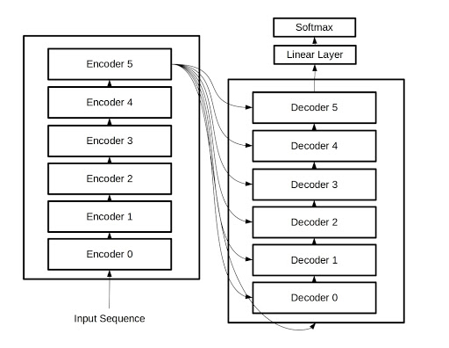
The Transformer Block: Deep Dive into Architecture
The Transformer architecture is built on an Encoder-Decoder structure.
Encoder: Processes the input sequence and creates a mathematical representation of it.
Decoder: Uses the encoder's output and previous generated tokens to predict the next word.
This architecture is the foundation for models like GPT, Llama, and DeepSeek.

Slide 3
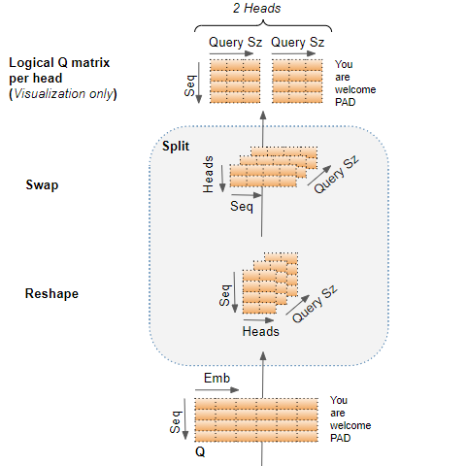
Multi-Head Attention: Focusing on Multiple Details
Instead of performing attention once, "Multi-Head" attention runs multiple attention mechanisms in parallel.
This allows the model to focus on different parts of a sentence simultaneously (e.g., one head focuses on the subject, another on the verb).
The results from all "heads" are concatenated and transformed to produce the final output.

